Slide 1

VEHICLE MOVEMENT ANALYSIS AND INSIGHT GENERATION IN A COLLEGUE CAMPUS USING EDGE AI
DONE BY
P.YASMEEN BEGUM
MANIPAL INSTITUTE OF TECHNOLOGY
215811050

Slide 2
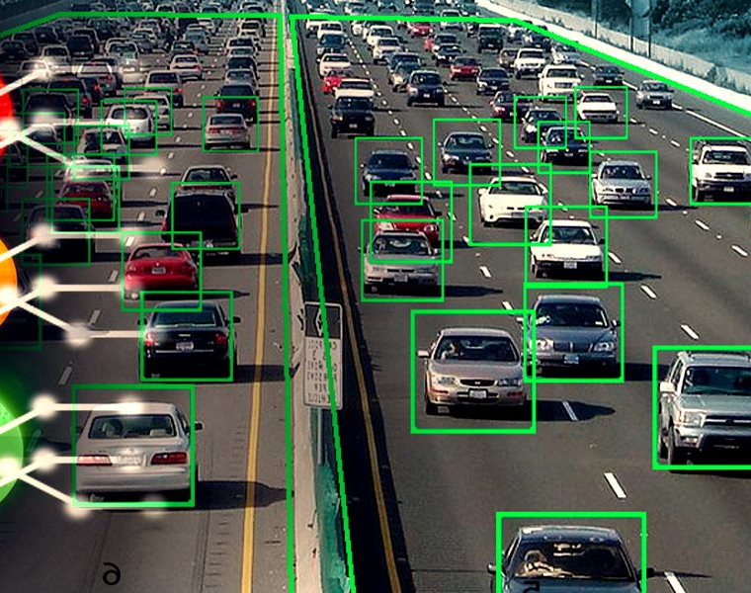
Objective:
Develop an Edge AI-based solution to analyze:
Vehicle movement,
Monitor parking occupancy,
Match vehicles to an approved database using data from campus cameras.

Slide 3
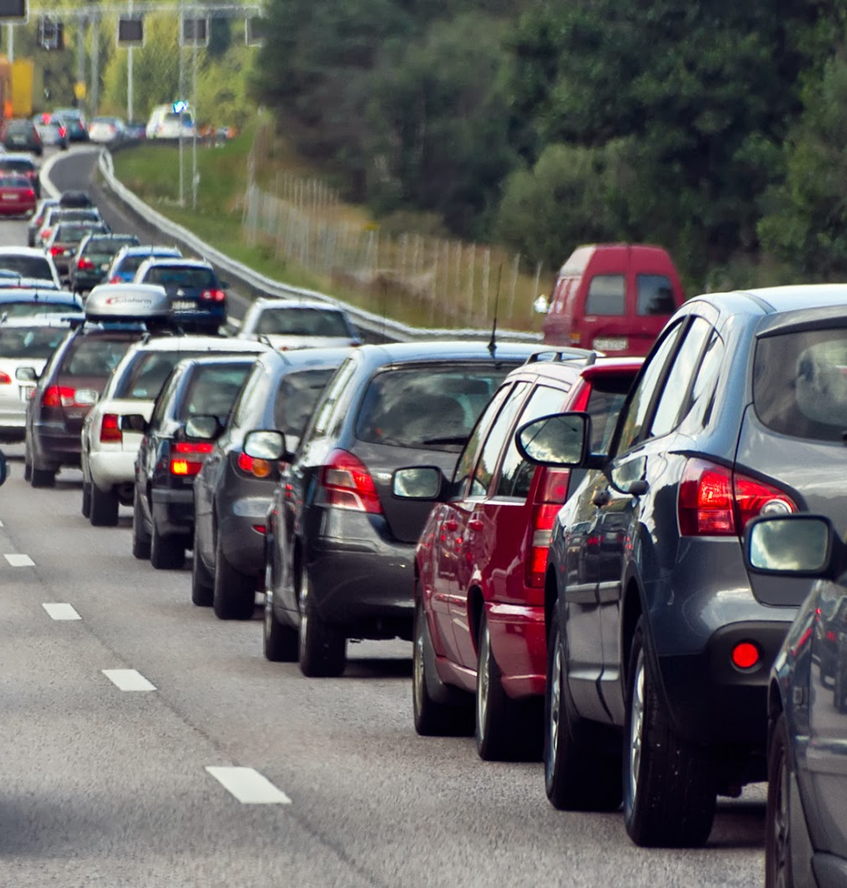
Unique Idea Brief (Solution) Real-time Vehicle Movement Analysis:
Edge AI processing: Use cameras equipped with edge AI capabilities to analyse vehicle movements directly in the campus;
Pattern Recognition: Identify peak entry and exit times in order to optimise traffic flow.

Slide 4
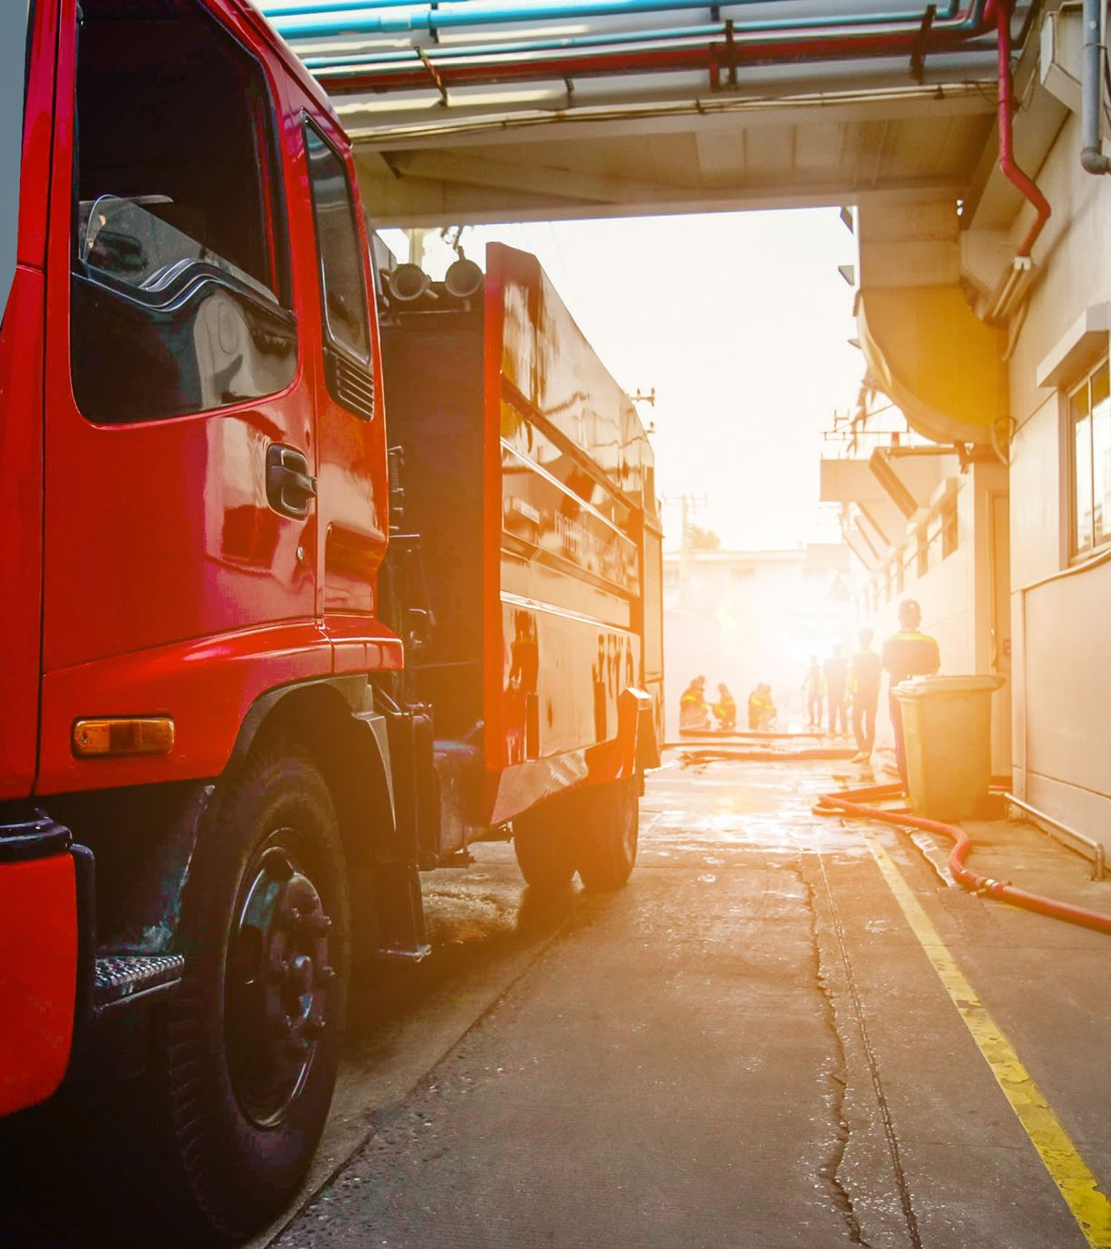
Unique Idea Brief (Solution) Parking Occupancy Monitoring:
Live Occupancy Tracking: Continuously monitor parking lot usage with cameras and Edge AI, providing up-to-the-minute occupancy data.
Optimized Space Utilization: Recommend available parking spaces

Slide 5
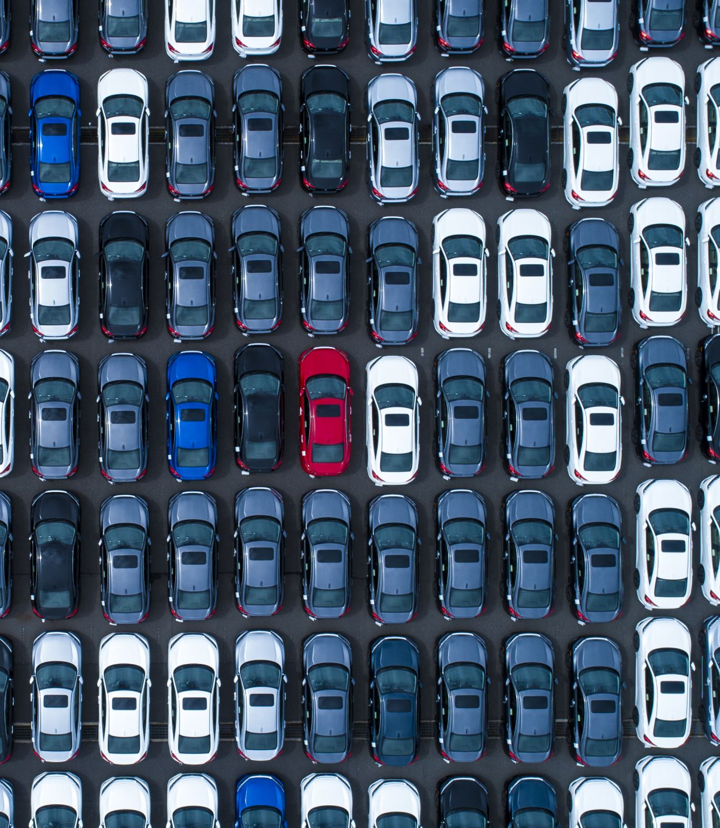
Licence plate detection and matching vehicles to a database:
License Plate Recognition (LPR): Use high-accuracy LPR to capture and analyze license plates in real-time
Database Matching: Instantly compare captured plates against an approved vehicle database to identify unauthorized vehicles.

Slide 6
Unique Idea Brief (Solution): Insight Generation:
Movement Insights: Generate detailed reports on vehicle movement patterns, helping campus administration make informed decisions.
Parking Analytics: Provide analytics on parking lot usage, peak times, and occupancy trends.
Security Reports: Identifying authorized and unauthorized vehicles from the vehicles entering the campus.

Slide 7
Solution Features: Data Preprocessing for Vehicle Movement Analysis
Effective Cleaning
Remove noise and irrelevant details from images Standardize image formats to ensure consistency (e.g., convert all images to JPEG).
Handling Missing Values
Identify missing or incomplete data entries.
Use imputation techniques, such as filling with mean values or using predictive models to estimate missing data.

Slide 8
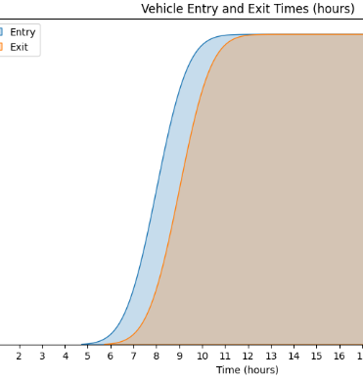
Accurate Analysis of Vehicle Movement Patterns:
Real-Time Tracking:real-time vehicle detection and tracking.
Timestamp Analysis: Analyze entry and exit times to determine peak traffic periods.
Hourly Distribution: Create histograms showing vehicle counts per hour.

Slide 9
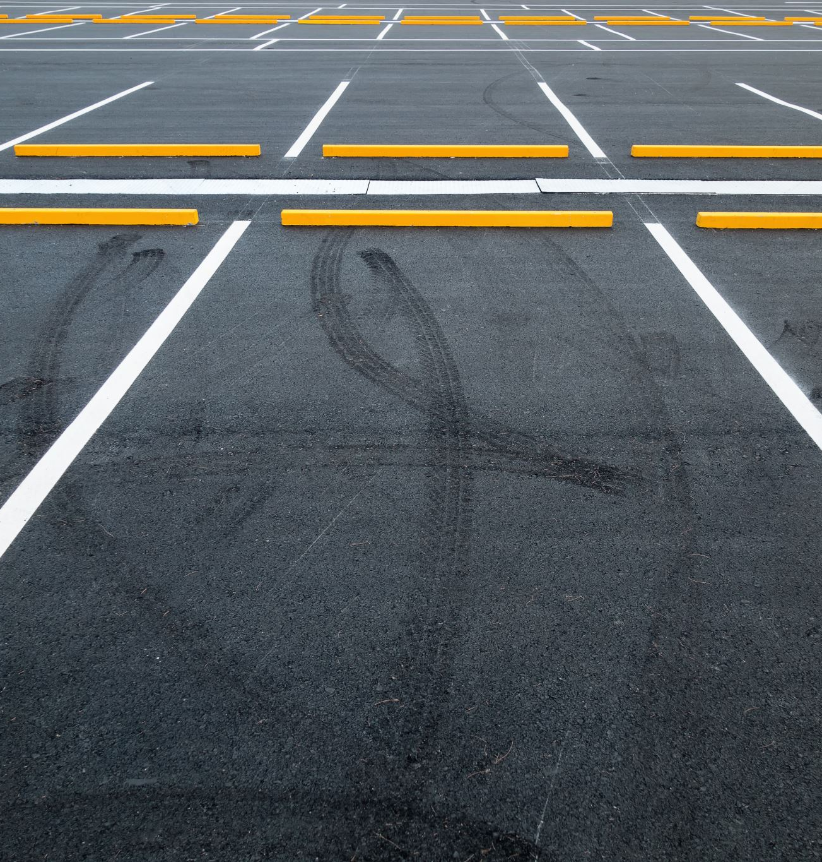
Parking Occupancy:
Movement Patterns: Detect common routes and areas with high traffic flow.
Parking Duration: Measure how long vehicles stay parked in different areas.
Recurring Vehicles: Identify vehicles that frequently enter and exit the campus, indicating regular users.

Slide 10
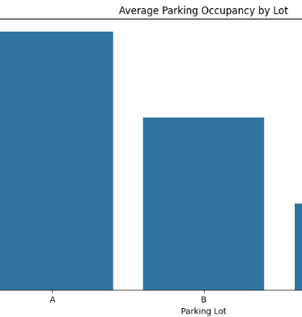
Insight Generation:
Traffic Flow: Analyze traffic flow patterns to identify congested areas and times.
Parking Occupancy: Monitor parking lot occupancy rates and identify frequently occupied spots.
Usage Trends: Determine trends in vehicle usage, such as peak times, average stay duration, and most common entry/exit points.

Slide 11
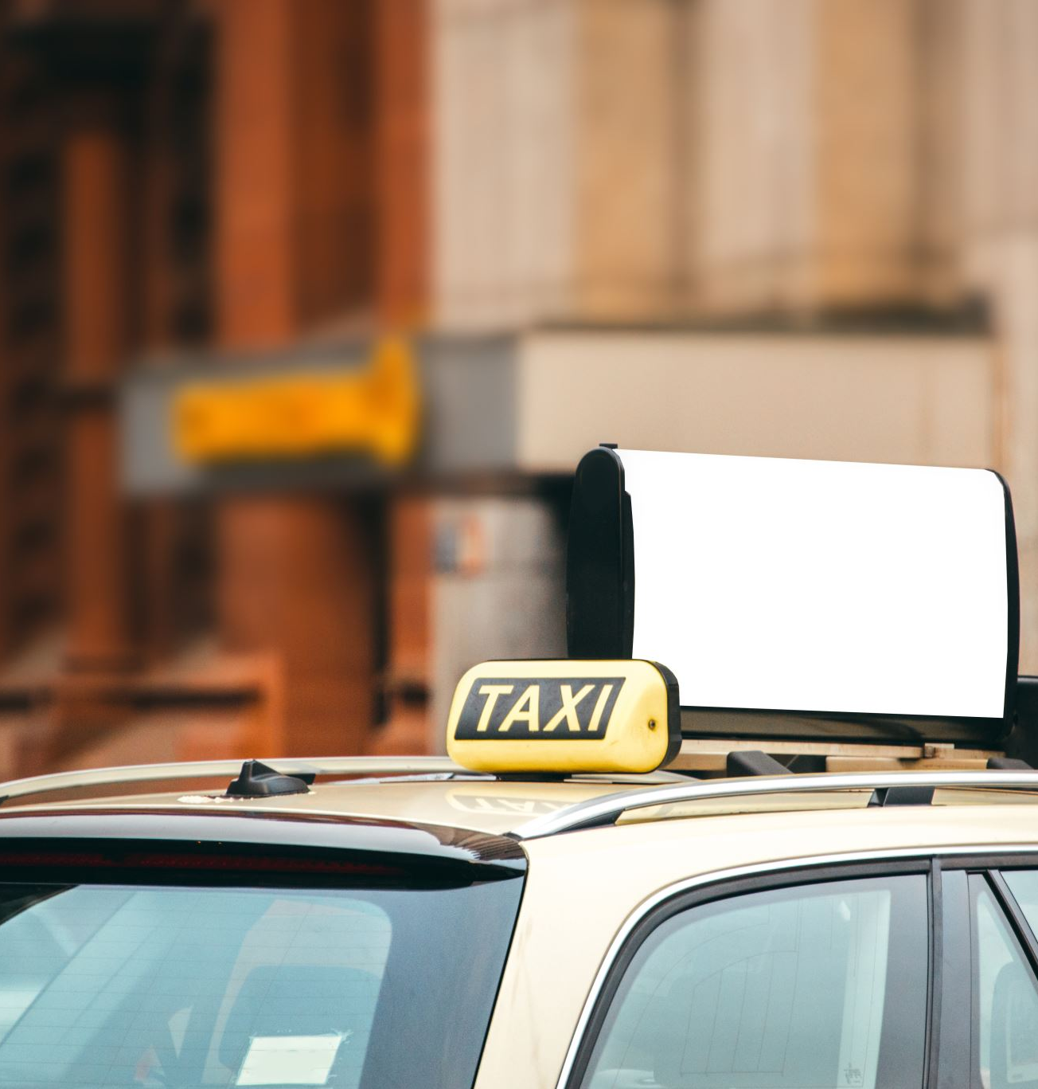
Vehicle matching:
Approved Vehicle Database: Connect to the college's approved vehicle database containing details of authorized vehicles.
Real-Time Processing: Enable real-time matching to instantly verify vehicle authorization upon entry.
Screenshots: Display examples of matched and unmatched vehicle records.

Slide 12
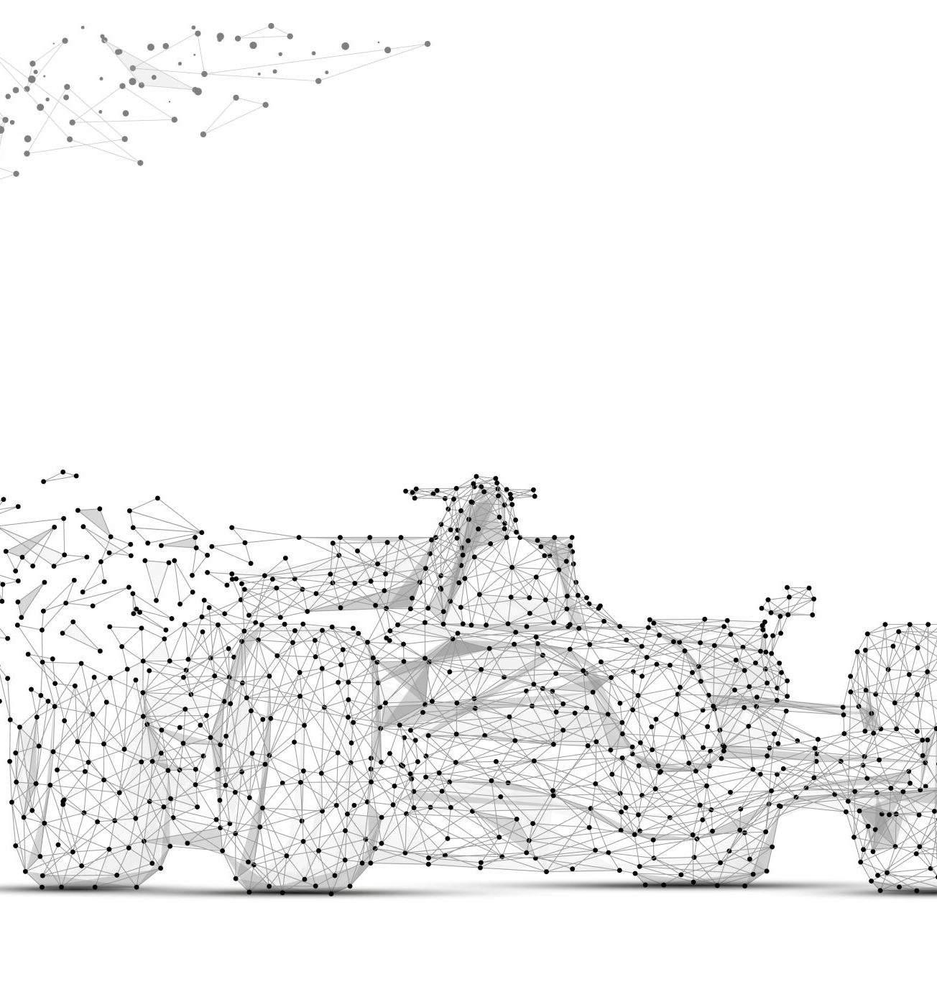
Process Flow :
Image Processing and OCR
Use advanced image processing techniques and OCR to extract license plate numbers from captured images.
Database Comparison
Compare extracted license plate data against an approved vehicle database to distinguish authorized and unauthorized vehicles.
Vehicle Movement Analysis
Analyze the frequency and timing of vehicle entries and exits to identify peak times and traffic patterns.
Parking Occupancy Monitoring
Monitor real-time parking lot occupancy to identify frequently used lots and peak usage times.

Slide 13
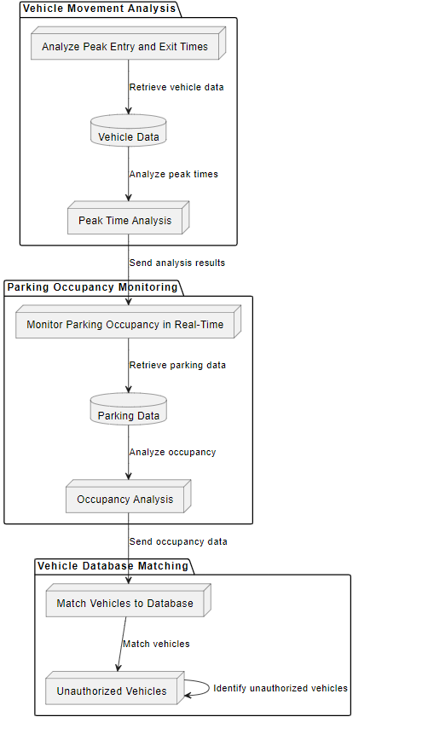
ARCHITECTURE DIAGRAM:
Vehicle Movement Analysis: Continuously track vehicle entries and exits
Parking Occupancy Monitoring: Monitor real-time parking lot occupancy to identify frequently used lots and peak usage times.
Security Enhancement: Enhance campus security by promptly identifying unauthorized vehicles
Actionable Insights: Generate insights that optimize campus operations,

Slide 14

Technologies used:
Load the Dataset : Python, OpenCV
Data Preprocessing : OpenCV, Pandas, NumPy
Exploratory Data Analysis (EDA) : Matplotlib, Seaborn
Vehicle Matching: OpenCV, Tesseract OCR
Insight Generation : Pandas, Matplotlib
Implementing the Solution :TensorFlow Lite, OpenVINO

Slide 15
CONCLUSION:
In conclusion, our intelligent system for managing vehicle movement and parking on campus represents a transformative approach to enhancing security and operational efficiency. Through strategic camera deployment and advanced image processing techniques including OCR, we ensure accurate identification of vehicles and their authorization status. This system monitors parking lot occupancy. By promptly identifying unauthorized vehicles and supporting effective parking strategies, we bolster campus security while improving overall operational efficiency. Embracing these technologies not only meets the current demands of our campus but also prepares us for future growth ultimately enriching the experience of all campus stakeholders.

